Slide 1
eDoc person

Slide 2
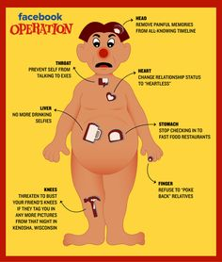

Slide 3
Find my organs!

